Slide 1

Bright Coffee Shop Analysis

Slide 2
Bright Coffee Shop at a Glance
698812
9
3
Total Revenue
Products Category
Store Locations

Slide 3
Bright Coffee Shop at a Glance
149116
29
1,44
Units Sold
Products Types
Average Order Value

Slide 4

Agenda
Which products generate the most revenue
What time of day the store performs best
Sales trends across products and time intervals
Recommendations for improving sales performance

Slide 5
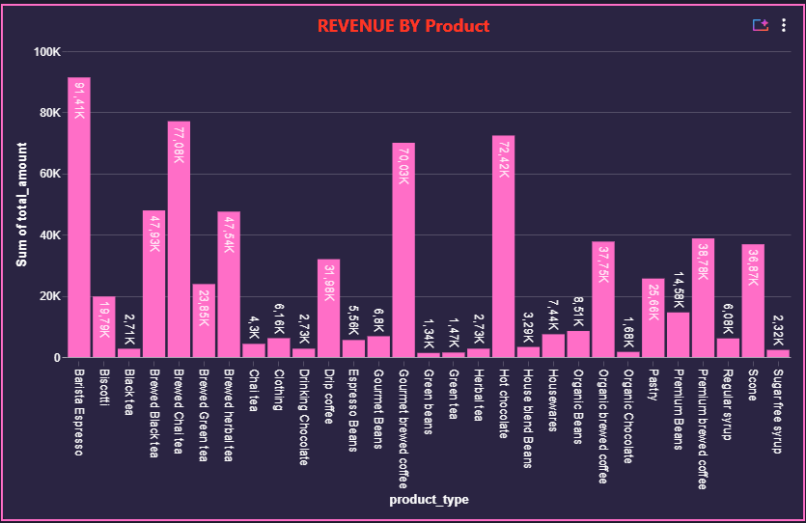
Which products generate the most revenue
5
Barista Espresso leads at R91.4K (13.1%), followed by Brewed Chai tea (R77.1K, 11.0%) and Hot chocolate (R72.4K, 10.4%). Gourmet brewed coffee adds R70.0K (10.0%). The top 10 products collectively generate $551.8K, representing 79.0% of total revenue.

Slide 6
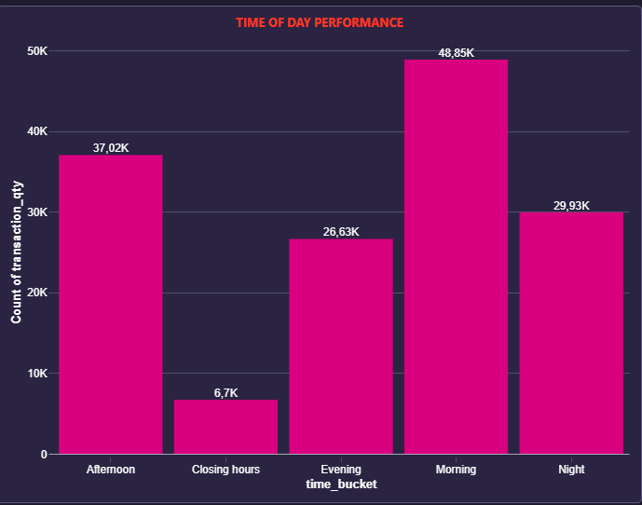
What time of day the store performs best
6
Day-of-Week Patterns
Tuesday mornings are the strongest (R35.4K), followed by Friday and Sunday mornings (R33.9K and R32.9K). Weekday mornings consistently outperform weekend mornings, suggesting a strong commuter/work-day customer base.

Slide 7
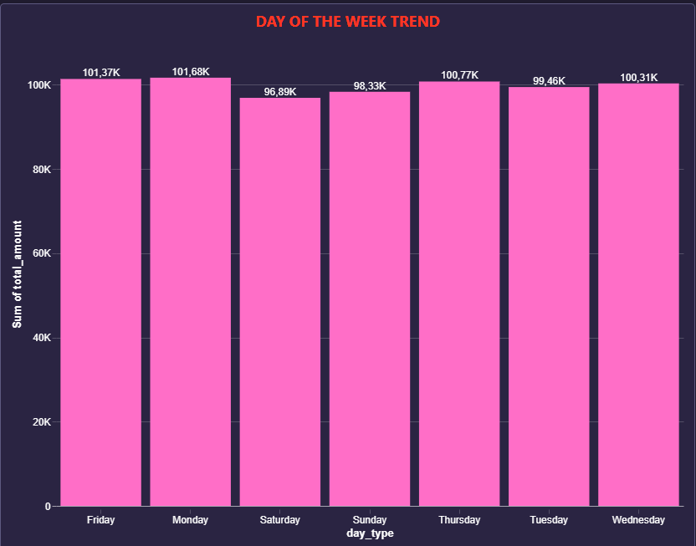
Sales trends across products and time intervals
7
Strong Upward Growth Trajectory with Accelerating Momentum
Bright Coffee Shop demonstrates robust growth from January through June 2023, with revenue more than doubling from R81.7K to R166.5K (+104% total growth). The business shows accelerating momentum, particularly from March onward.

Slide 8


Strategic Recommendations
Growth Opportunities
1. Premium Beverage Focus
Large-size specialty drinks generate highest revenue per transaction
Expand premium hot chocolate and espresso offerings
Consider seasonal premium variants to drive average transaction value
.
Growth Opportunities
2. Optimize Morning Operations
Ensure maximum staffing 8-10 AM to handle peak volume (17,654-18,545 transactions/hour)
Stock premium products heavily for morning rush
Consider express lanes or mobile ordering to reduce wait times
.
,

Slide 9
Strategic Recommendations
Growth Opportunities
Capitalize on Growth Momentum
The business is in a high-growth phase — invest in capacity, inventory, and staffing to support continued expansion
May's 31.8% surge suggests untapped demand; ensure operational readiness for similar spikes
.
Growth Opportunities
2. Address February Seasonality
Plan for the predictable February dip with targeted promotions or cost management
Consider Valentine's Day campaigns or winter-specific products to offset seasonal weakness
.
,

Slide 10
THANK YOU

